Slide 1
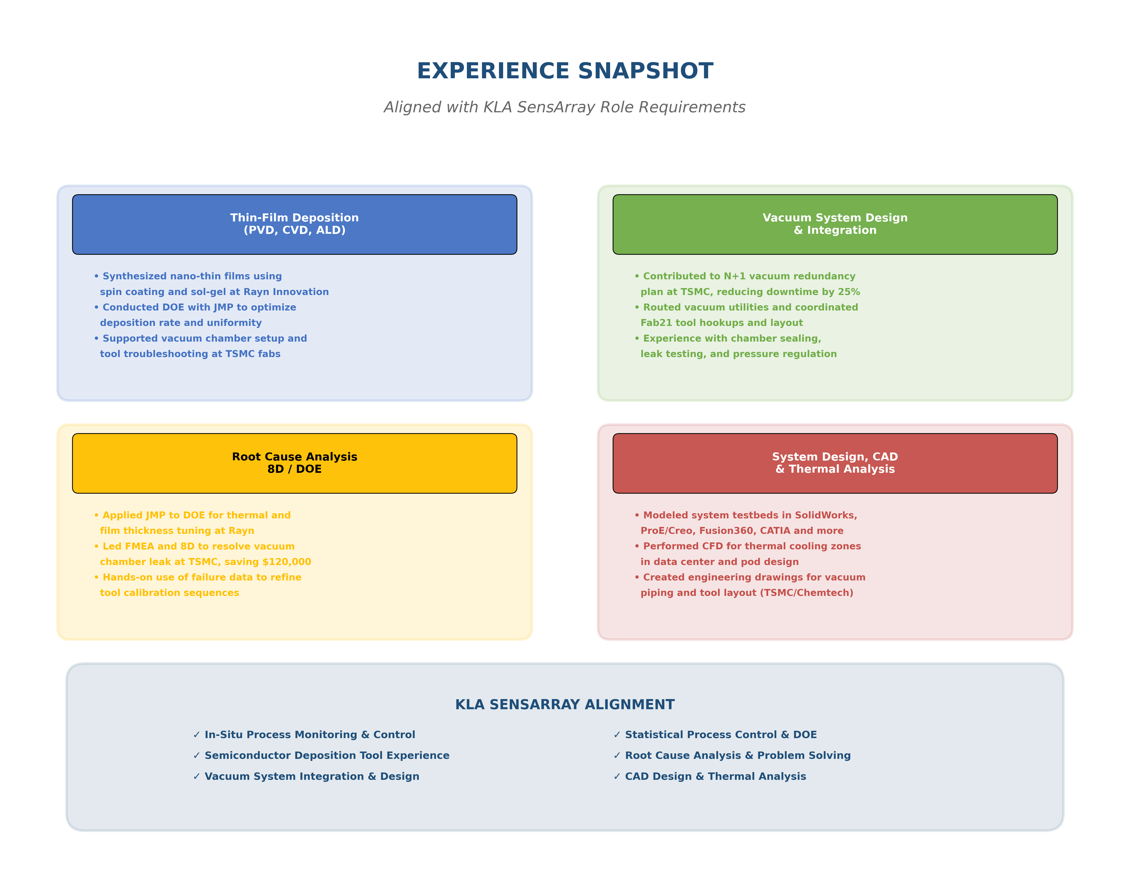
Experience Snapshot - KLA SensArray Alignment

